Slide 1
Promoting Health in Nevada Analyzing Nevada Demographics and BRFSS Data: (Ever Told) Had Skin Cancer
Will Bliss

Slide 2
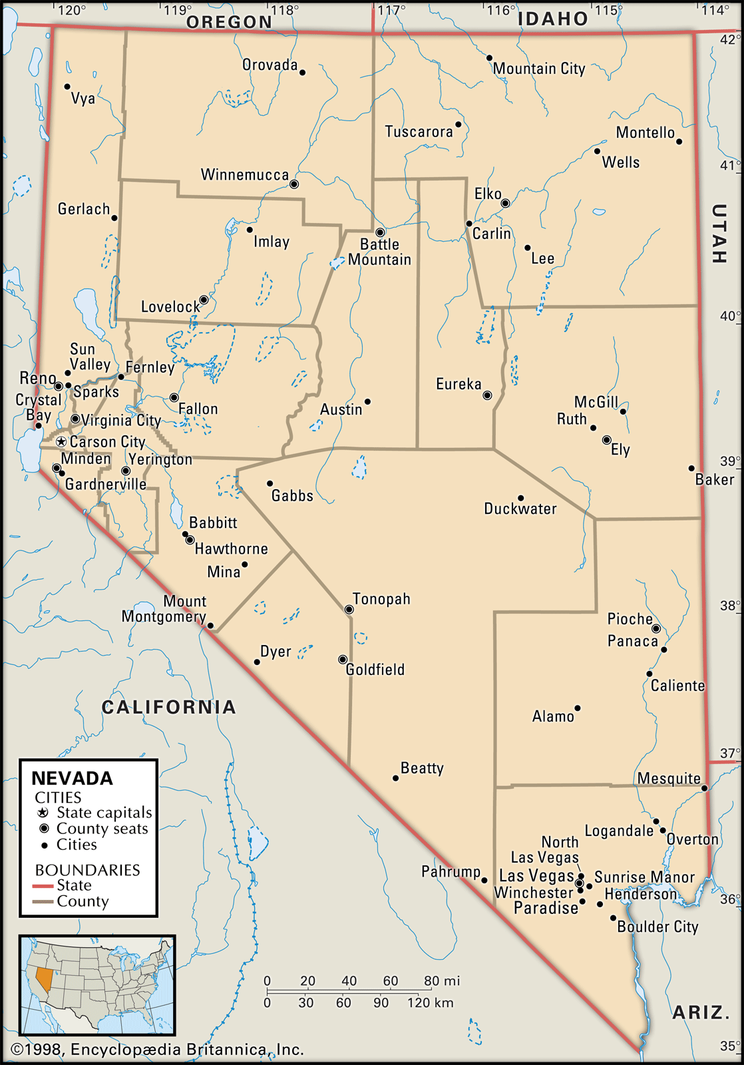
About Nevada
16 Counties
Washoe County makes up 15.6% of Nevada population (2010)
Clark County makes up 72.25% of Nevada population (2010)
Population Per Square Mile (2010): 24.6
Land Area in Square Miles (2010): 109,781

Slide 3
US vs. Nevada
United States
Population: 328,239,523 (2019)
14.1% Living in Poverty (2018)
3,791,712 Births (2018)
2,839,205 Deaths (2018)
7,685,444 Net Migration (2010-2019)
$60,293 Median Salary (2018)
Nevada
Population: 3,080,156 (.94%)
13.7% Living in Poverty
35,682 Births (.94%)
24,715 Deaths (.87%)
259,096 Net Migration (3.37%)
$57,598 Median Salary

Slide 4
US: 6.1 Nevada: 14.0

Slide 5
US: 14.1 Nevada: 13.7

Slide 6
US: $60,293 Nevada: $57,598

Slide 7
US: 31.5 Nevada: 24.2

Slide 8
US: 39.9 Nevada: 51.8

Slide 9
Using the BRFSS14 Data
Table 1) Characteristics of Respondents, BRFSS, Nevada, 2014
 |  | N | %
Total |  | 39585 | 100
Sex | Female | 2150 | 57.14
 | Male | 1613 | 42.86
Age | 18-34 yrs | 585 | 15.55
 | 35-64 yrs | 1882 | 50.01
 | 65+ yrs | 1296 | 34.44
Education | College Graduated | 1207 | 32.32
 | High School or Less | 1305 | 34.94
 | Some College | 1223 | 32.74
Race/Ethnicity | Hispanic | 468 | 12.66
 | Others | 483 | 13.07
 | White | 2745 | 74.27
Income | $29k - | 874 | 27.36
 | $30k-49K | 832 | 26.04
 | $50k+ | 1489 | 46.6
Marital Status | No | 1839 | 49.4
 | Yes | 1884 | 50.6
Delayed Medical | No | 2576 | 72.93
 | Yes | 956 | 27.07
Health Plan | Medicaid | 206 | 6.58
 | No Plan | 23 | 0.74
 | Other Plans | 2900 | 92.68
General Health | Excell/Good | 3024 | 80.51
 | Fair/Poor | 732 | 19.49
Heavy Drinker | No | 3295 | 92.71
 | Yes | 259 | 7.29
(Ever Told) Had Skin Cancer | No | 3331 | 89.09
 | Yes | 408 | 10.91

Slide 10
Using the BRFSS14 Data
Table 2) Prevalence of (Ever Told) Had Skin Cancer by Characteristics, BRFSS, Nevada, 2014
 |  | % | 95% C.I. |  | P-Value
Sex | Female | 5.7079 | 4.6024 | 6.8134 | 0.1927
 | Male | 6.9391 | 5.4043 | 8.474
Age | 18-34 yrs | 0.3553 | 0 | 0.7802 | <.0001
 | 35-64 yrs | 5.5171 | 4.0612 | 6.973
 | 65+ yrs | 18.308 | 15.4751 | 21.141
Education | College Graduated | 8.4797 | 6.5389 | 10.4205 | <.0001
 | High School or Less | 3.8553 | 2.6177 | 5.0929
 | Some College | 8.556 | 6.6266 | 10.4854
Race/Ethnicity | Hispanic | 0.3755 | 0 | 1.05 | <.0001
 | Others | 0.784 | 0.0701 | 1.4979
 | White | 11.0142 | 9.3876 | 12.6408
Income | $29k - | 5.2663 | 3.0678 | 7.4647 | 0.3258
 | $30k-49K | 7.2319 | 5.2892 | 9.1746
 | $50k+ | 7.0958 | 5.5094 | 8.6822
Marital Status | No | 5.8493 | 4.442 | 7.2566 | 0.2815
 | Yes | 6.9148 | 5.6176 | 8.212
Delayed Medical | No | 6.2891 | 5.2516 | 7.3266 | 0.4927
 | Yes | 7.1354 | 4.8474 | 9.4234
Health Plan | Medicaid | 3.8108 | 1.006 | 6.6156 | 0.1798
 | No Plan | 9.2746 | 0 | 26.8298
 | Other Plans | 7.9769 | 6.7037 | 9.2501
General Health | Excell/Good | 5.9775 | 4.9549 | 7.0001 | 0.1368
 | Fair/Poor | 7.8377 | 5.394 | 10.2813
Heavy Drinker | No | 6.2833 | 5.2827 | 7.2839 | 0.3281
 | Yes | 8.5304 | 3.5172 | 13.5437

Slide 11
Using the BRFSS14 Data
Table 3) Adjusted Odds Ratio for (Ever Told) Had Skin Cancer by Characteristics, BRFSS, NV, 2014
 |  | aOR | 95% C.I. |  | P-Value
Sex | Female vs. Male | 0.6643 | 0.4418 | 0.999 | 0.0494
Age | 18-34 vs. 65+ | 0.0356 | 0.0101 | 0.1255 | <.0001
 | 35-64 vs. 65+ | 0.329 | 0.2146 | 0.5043 | <.0001
 | 18-34 vs. 35-64 | 0.1081 | 0.0298 | 0.3918 | 0.0007
Race/Ethnicity | Hispanic vs. White | 0.0854 | 0.015 | 0.5667 | 0.0101
 | Other vs. White | 0.0329 | 0.0309 | 0.177 | <.0001
 | Hispanic vs. Other | 0.0655 | 0.0963 | 0.3735 | <.0001
Education | High School vs. College | 0.8283 | 0.4898 | 1.4009 | 0.4821
 | Some College vs. College | 0.9907 | 0.6358 | 1.5439 | 0.9672
 | High vs. Some College | 0.836 | 0.5169 | 1.3521 | 0.4652
Marital Status | Non-Married vs. Married | 1.3022 | 0.85 | 1.995 | 0.225
Income | 29.9k- vs. 50k+ | 0.862 | 0.4284 | 1.7344 | 0.6771
 | 30-49.9k vs. 50k+ | 1.0964 | 0.7017 | 1.713 | 0.686
 | 29.9k- vs. 30-49k | 0.8951 | 0.66 | 1.2139 | 0.4757
General Health | Fair/Poor vs. Excel/Good | 0.6387 | 0.3602 | 1.1323 | 0.1248
Heavy Drinker | Yes vs. No | 1.6286 | 0.7467 | 3.5524 | 0.2202
Health Plan | No Plan vs. Medicaid | 1.0841 | 0.4456 | 2.6376 | 0.8587
 | No Plan vs. Other Plan | 1.2591 | 0.1999 | 7.9294 | 0.8061
 | Mediciad vs. Other Plan | 0.9941 | 0.3514 | 2.8118 | 0.991

Slide 12
The Facts
4th highest in population change
6th lowest in education
24th lowest in median income
25th lowest in poverty population
6th highest in population percentage of minorities
Most prevalent Education Status: High School or Less
Highest prevalence of (Ever Told) Had Skin Cancer by Education: College, Some College
Odds Ratios suggest that minorities are less likely to report skin cancer

Slide 13
What Does This Mean?
Even though the most common Education status is “High School or Less”, the most people with skin cancer are those with college degrees. With the lack of funding for health promotion, those with lower income are hurting.
Even though minorities make up the majority of Nevada, they are less likely to have skin cancer, according to the data. This is most likely not the case. It is more likely that minorities are not informed enough to get screenings.

Slide 14
Already Dedicated
http://healthiernv.org/resources/
http://dpbh.nv.gov/Programs/Office_of_Public_Healh_Informatics_and_Epidemiology_(OPHIE)/
Crisis Hotline: 1-800-273-8255 or Text CARE to 839863
Sexual Assault/Domestic Abuse Hotline: 1-775-221-7600 or Text SASS to 839863
Elder Abuse/ Child Abuse: 1-833-803-1183
Substance Abuse Help Line: 1-775-825-4357 or toll free 1-800-450-9530
Carson Tahoe Behavioral Health Services (Carson City) – 775-445-7756
Center for Behavioral Health – (Reno) 775-829-4472
Family Counseling Service (Reno) – 775-329-0623

Slide 15
Why Nevada is Qualified for Funding
Nevada is the lowest ranked state in public health funding.
4th fastest growing state
An investment of $10 per person per year in evidence-based programs in local communities that are proven to increase physical activity, improve nutrition, and prevent smoking or other tobacco use could save the country more than $16 billion annually within five years. This is a potential savings of $5.60 for every $1 invested.
Low-resource communities experience the largest health and economic benefits from increased local public health spending. Increased spending on public health programs is associated with a decrease in mortality from preventable causes of death such as cardiovascular disease, diabetes, stroke, and cancer.

Slide 16
References
https://www.prb.org/usdata/
https://www.census.gov/quickfacts/NV
Behavioral Risk Factor Surveillance System, 2014. Land Line and Cell Phone data
http://dpbh.nv.gov/Programs/Office_of_Public_Healh_Informatics_and_Epidemiology_(OPHIE)/
http://healthiernv.org/resources/
https://www.americashealthrankings.org/explore/annual/measure/PH_funding/state/NV
https://www.britannica.com/place/Nevada-state
https://www.leg.state.nv.us/Division/Research/Documents/PopulationofCountiesInNevada2020Projected.pdf

Slide 17

Questions?

